Slide 1
Scoping future challenges and opportunities
Susannah Davidson and Daryl Parsons

Slide 2
Welcome to the HR Forum
University of Brighton
  Susannah Davidson – Business Development Manager
  Daryl Parsons – Business Development Advisor
Your business needs
Projects
Placements
Internships
Partnership
Recruitment
Professional Development & Training
Funding & Grants
Collaborative Research & Consultancy
Notes:
Welcome to the HR Forum
Thank you to Steve for inviting the UoB here today
Susannah and I work very closely with businesses and organisations across the GD area.
Susannah tends to focus on the large companies
And I on the small to medium

Slide 3
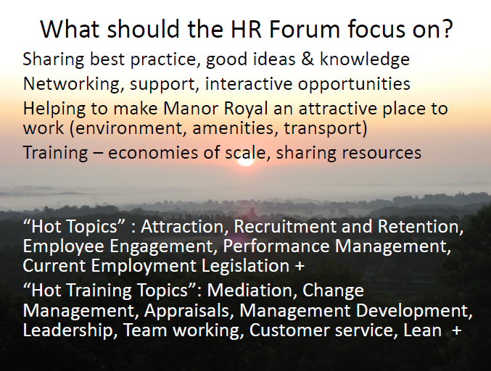
HR Forum
The MRBID HR Forum an excellent base to share ideas, for collaboration and to develop business support
In 2014, members of the Forum shared their top 3
Challenges
Opportunities
Topics
Development needs
Notes:
Some of you may remember and may have been part of
HR Forum in 2014 Derek Osborn from the CIPD conducted a workshop where members of the forum shared their top 3

Slide 4
HR Forum 2014
Top 6 themes
  Leadership development
  People management skills
  Organisational Change
  Recruitment
  Retaining our talent
  Employee engagement
Notes:
From the information collected there was a lot of similarity and 6 top themes emerged as the front runners
The MRBID have worked with Central Sussex College over the last 18 months putting together a very good programme to enhance skills for employees such as Excel Manual Handling
2016 – time for review to see were we are with these themes
are they still a challenge?
Have the themes changed
Is it a topic for thefuture HR Forum or a training programme?
To find out more we are asking you to take part in an action inspired activity.
Hopefully you all had time to give some thought to the pre session exercise and it is these thoughts that we will be working with

Slide 5
Action Learning
Share a challenge
Peer to peer best practice
No idea is a bad idea
Retain complete confidentiality
Notes:
For this we are going to split into 2 groups
And we keep to time we should have time for 2 or 3 Action Learning
The idea is that someone in the group shares a business challenge or an opportunity/ ambition
The learning and solution is generated through peer to peer experiences
Please remember that there is no such thing as a bad idea – so no holding back
One thing that is so important is complete confidentiality – what is said in the room stays in the room. For this purpose I have a flip chart which we will all sign to confirm that we will retain confidentiality

Slide 6
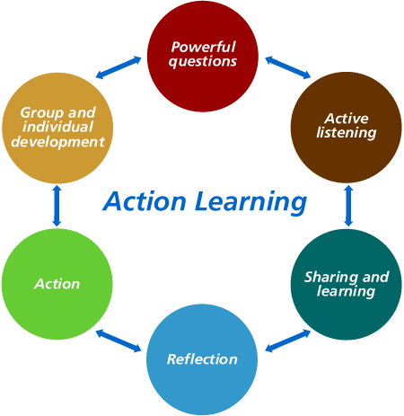
How does Action Learning work
Notes:
Based on the theory from Kolb experiential Learning Cycle
A challenge or opportunity is shared
The other members of the group then do some deep dive questioning to understand the issue fully and to start to explore ways forward.
Once the questioning is complete the group move into solution based feedback – providing the sharing and the learning experience.
The owner of the challenge then is able to reflect on the solutions and ideally create an action plan for Team and individual development

Slide 7
Action Learning
Identify a challenge – explain it to the group (5 min)
Ask questions to delve deeper and gain clarification – (5 min)
  What skills do you need to develop to take this on?
  What are the effects on others?
  What have you tried?
Solutions feedback (10 min)
Identify 3 or 4 points to create an action plan to take away (2 min)

Slide 8
Action Learning examples
I am looking to grow my management team. How can I find the right talent?
I am keen to start a mentoring scheme in my business. Where do I start?
How do I make time for my own personal development?
The Operational Director has resigned and as a business we don’t have anyone ready to step up. Any suggestions?

Slide 9

Summary – next steps
Work with MRBID to support the local businesses
Analyse the information that we have taken today
Identify development streams for the HR Forum
Your business needs
Projects
Placements
Internships
REQ of in-house training
Recruitment
Professional Development & Training
Funding & Grants
Collaborative Research & Consultancy

Slide 10
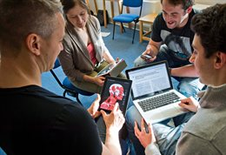
Thank you for taking part today
Contact details
Business Helpdesk
  businesshelpdesk@brighton.ac.uk
  01273 643098
  Susannah Davidson – 07958 515 487
  Daryl Parsons – 07944 052 806

